Slide 1
DYE3 ADSORPTION

Slide 2
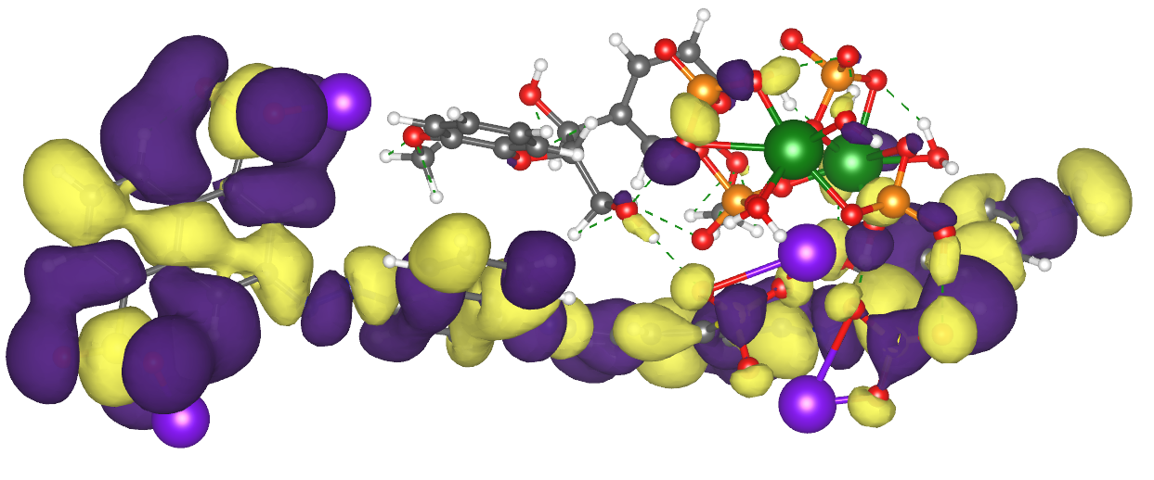
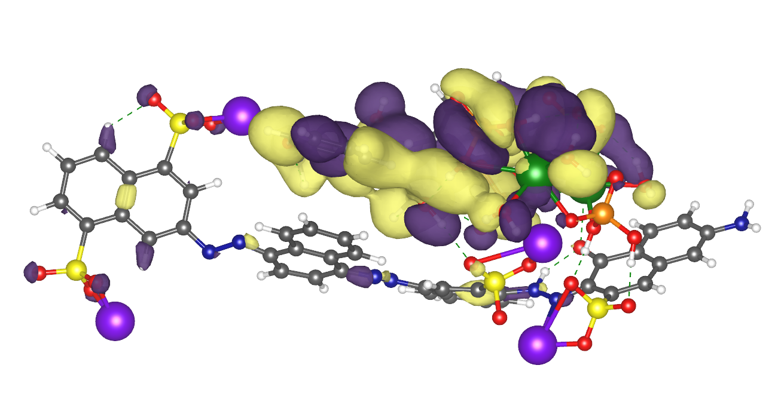
homo
lumo
Lignin-Brushite-dye3

Slide 3
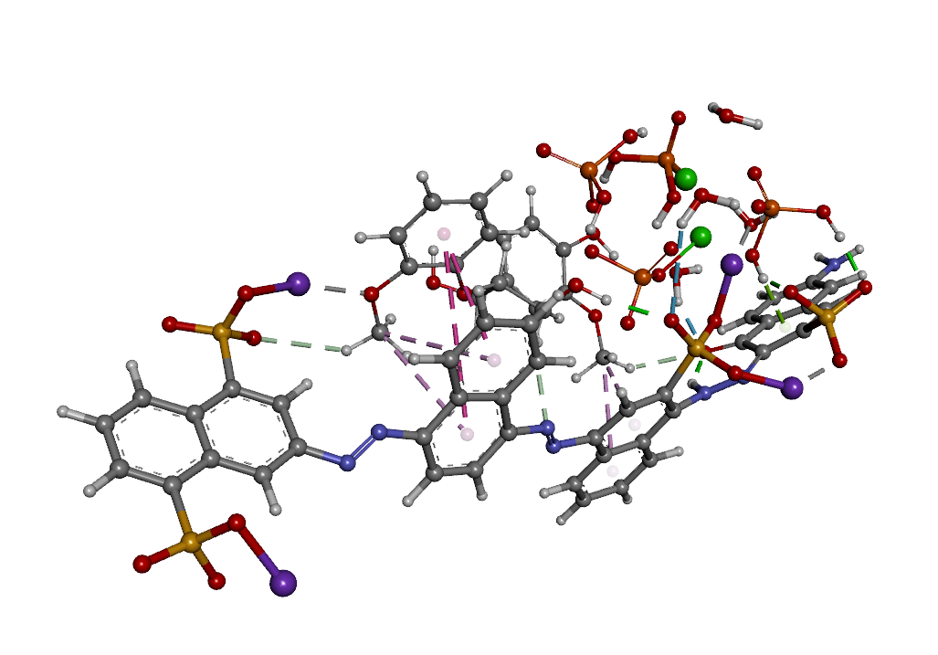
Lignin-Brushite-dye3
Optimized Structure

Slide 4
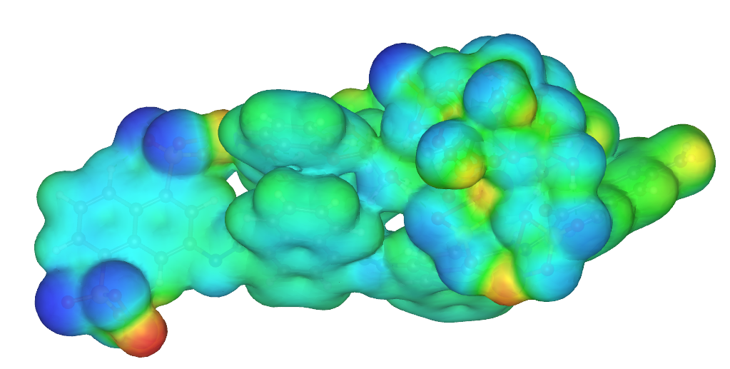
Lignin-Brushite-dye3

Slide 5
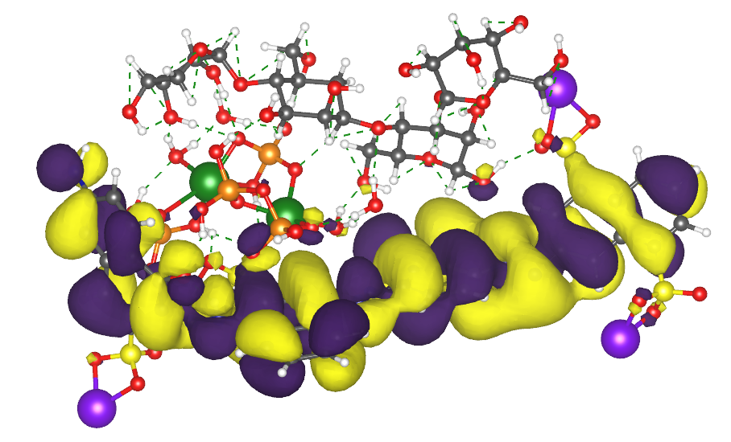
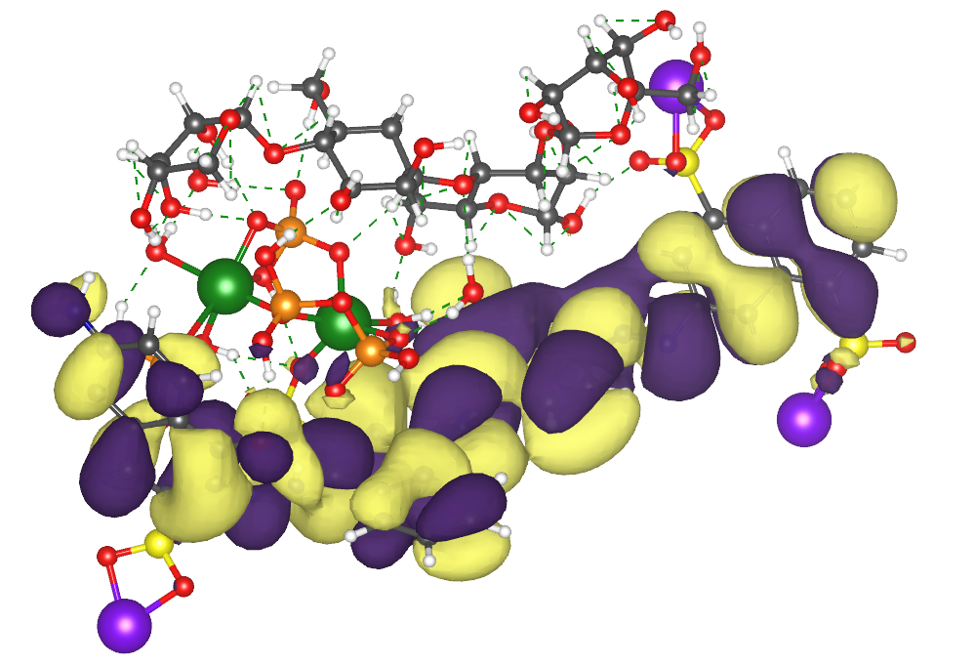
HEMICELLULOSE-BRUSHITE –DYE3
HOMO
LUMO

Slide 6
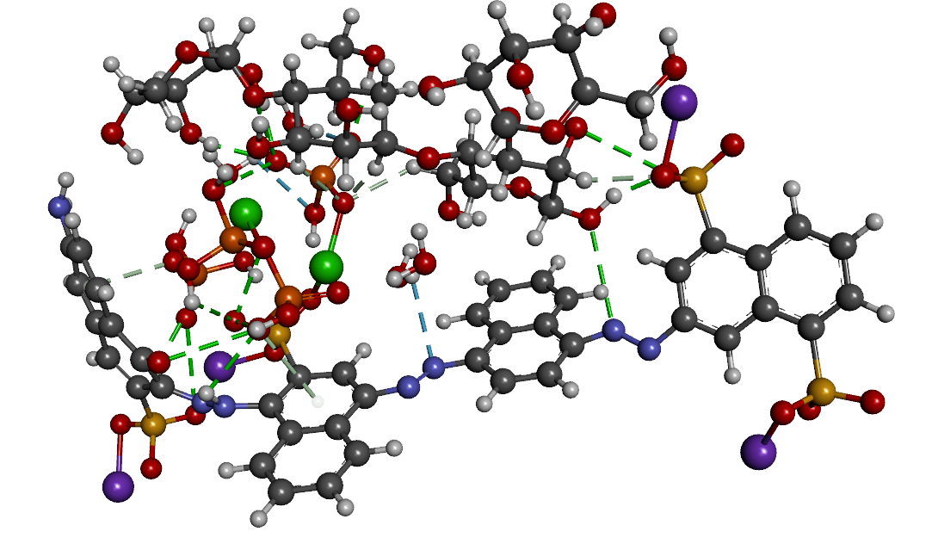
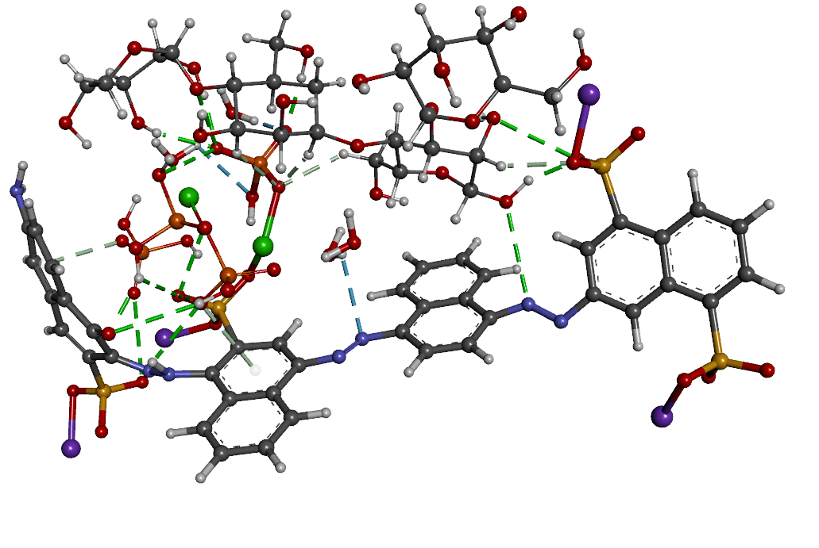
HEMICELLULOSE-BRUSHITE –DYE3
OPTIMIZED STRUCTURE

Slide 7
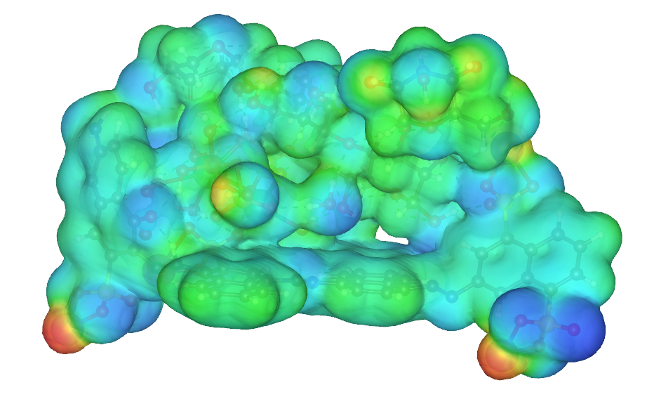
HEMICELLULOSE-BRUSHITE –DYE3
MEP

Slide 8
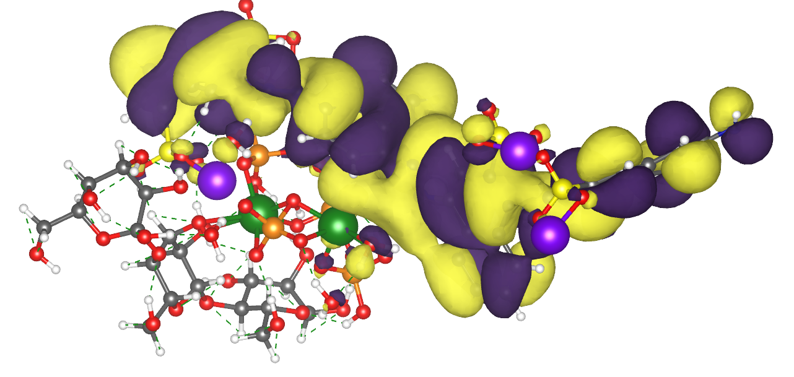
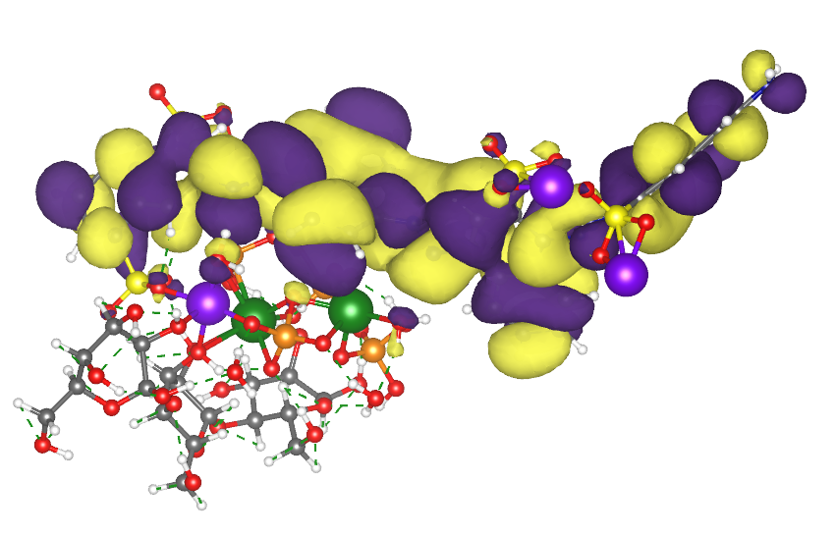
CELLULOSE-BRUSHITE –DYE3
HOMO
LUMO

Slide 9
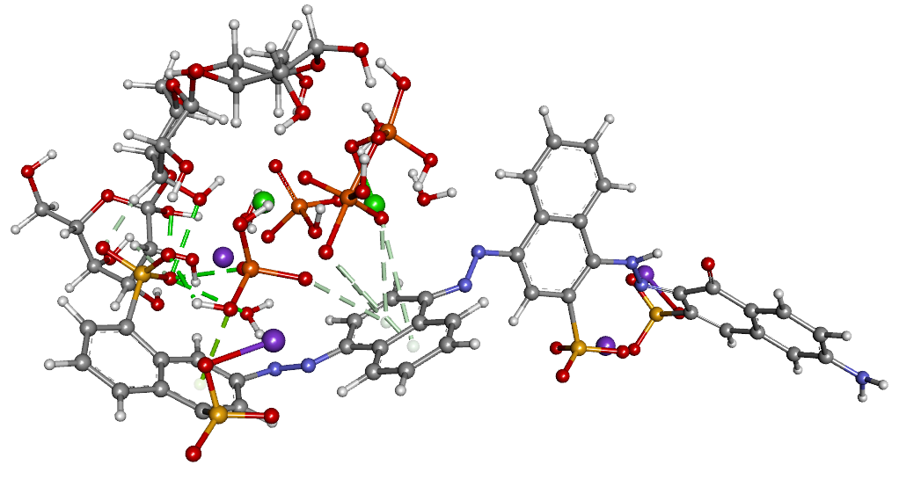
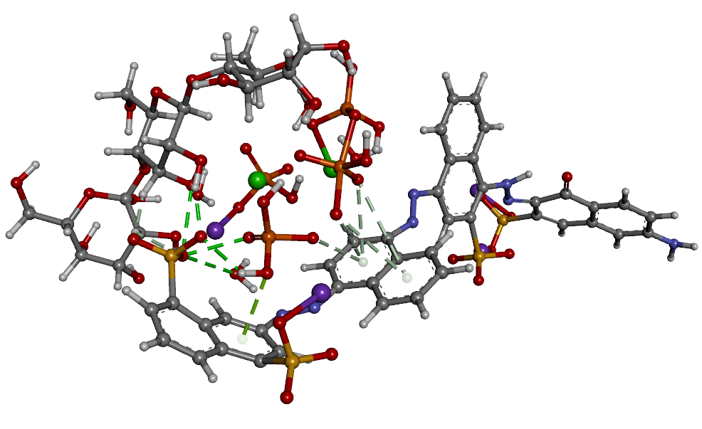
CELLULOSE-BRUSHITE –DYE3
OPTIMIZED STRUCUTRE

Slide 10
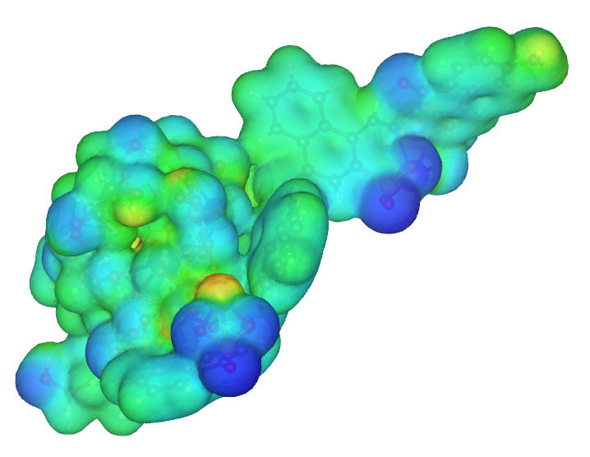
CELLULOSE-BRUSHITE –DYE3
MEP

Slide 11
DYE2 ADSORPTION

Slide 12
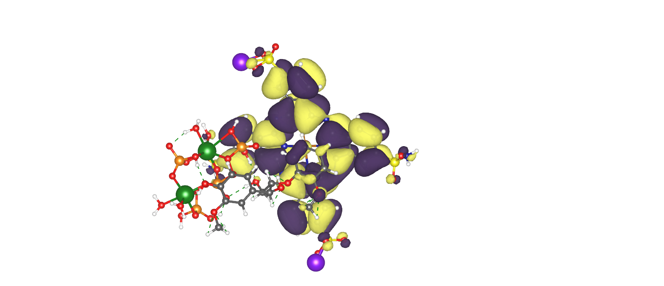
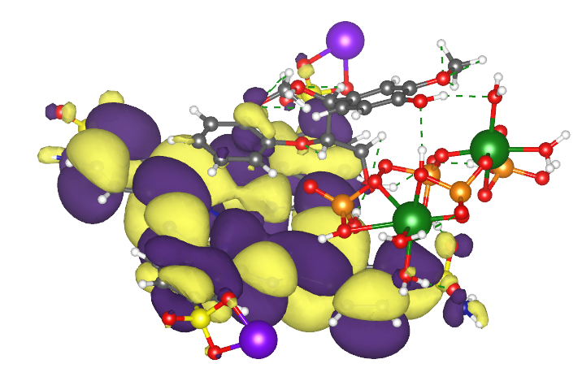
lignin-brushite-dye2
HOMO
LUMO

Slide 13
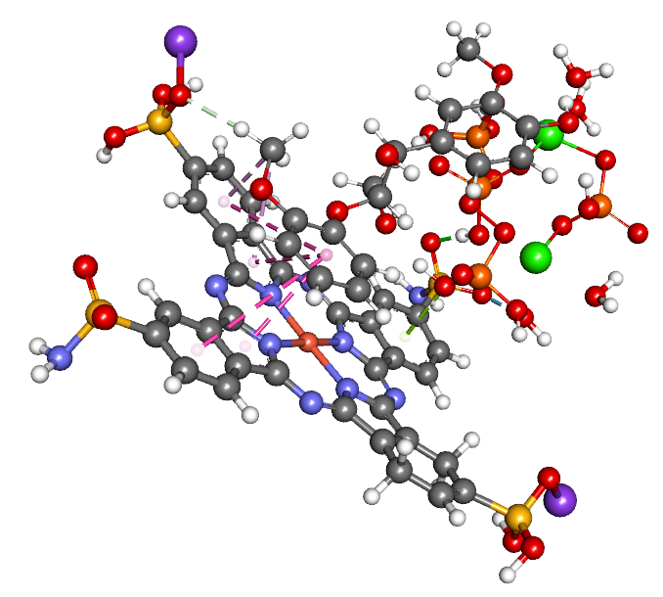
Interacting optimized structure of lignin-brushite-dye2

Slide 14
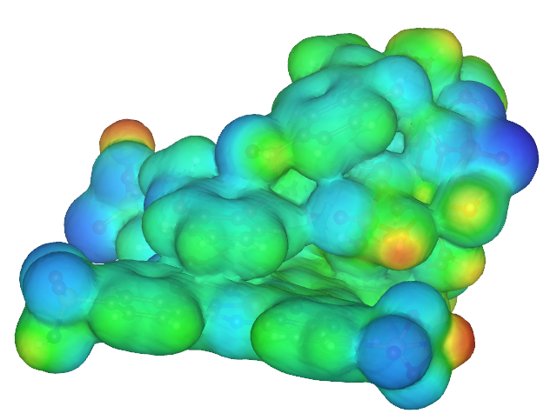
MEP of lignin-brushite-dye2

Slide 15
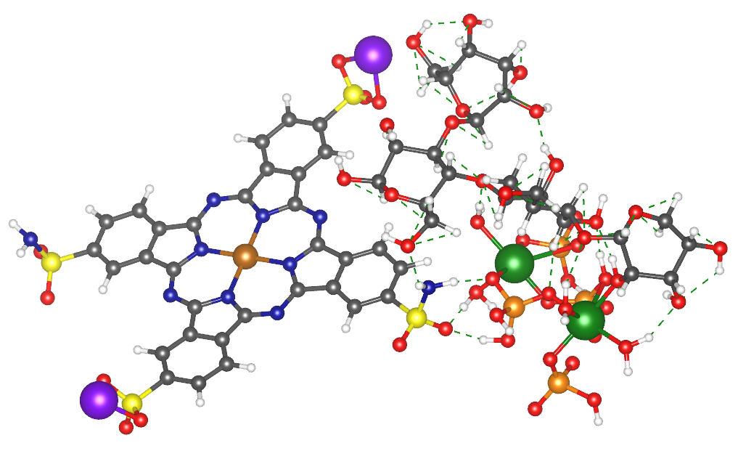
Interacting optimized structure of Hemicellulose-brushite-dye2

Slide 16
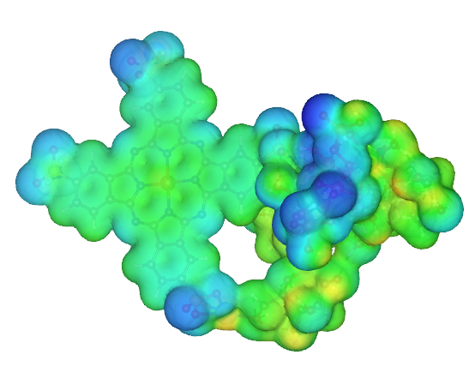
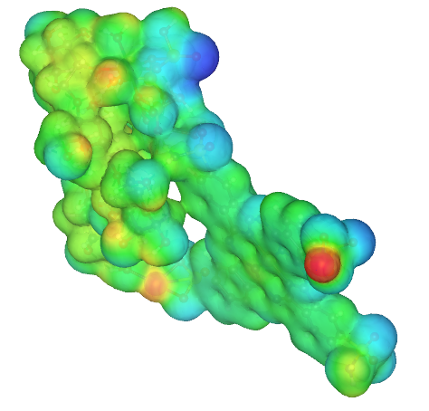
MEP of Hemicellulose-brushite-dye2

Slide 17
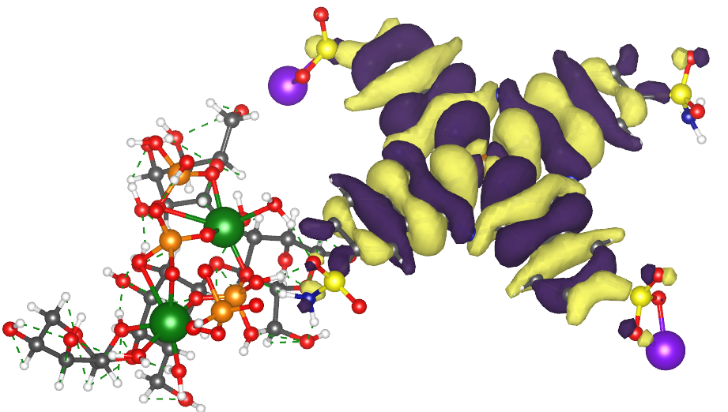
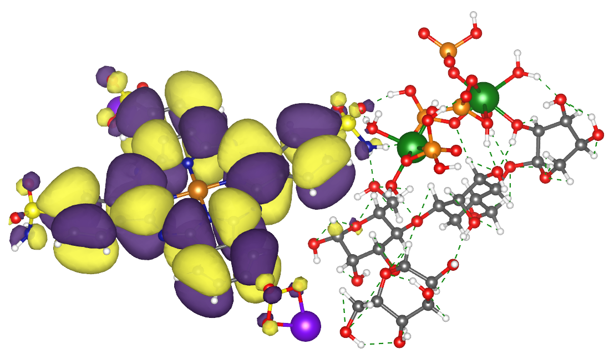
HOMO
Hemicellulose-brushite-dye2
LUMO

Slide 18
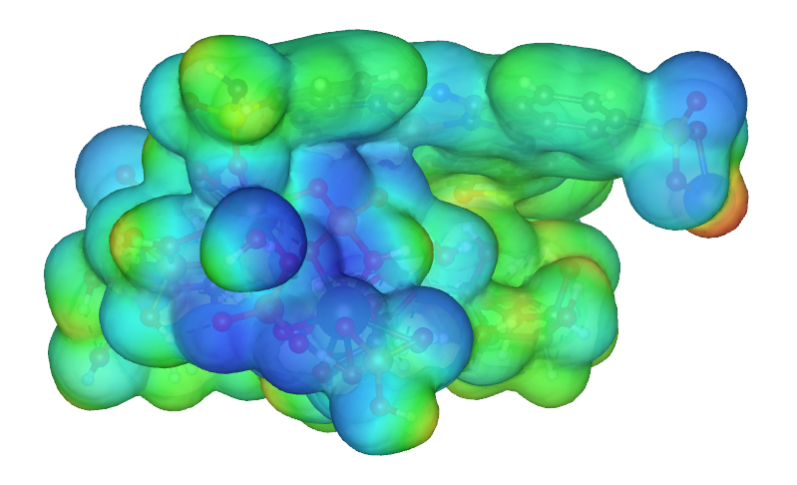
Cellulose-brushite-dye2

Slide 19
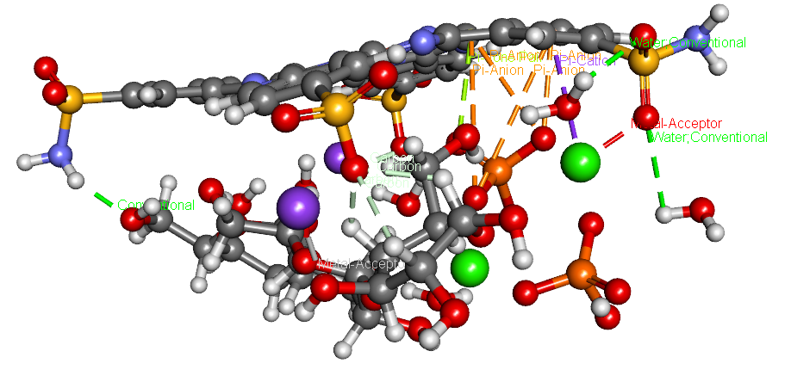
Cellulose-brushite-dye2

Slide 20
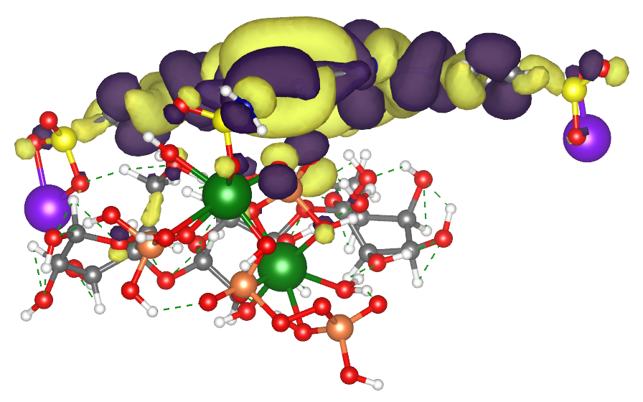
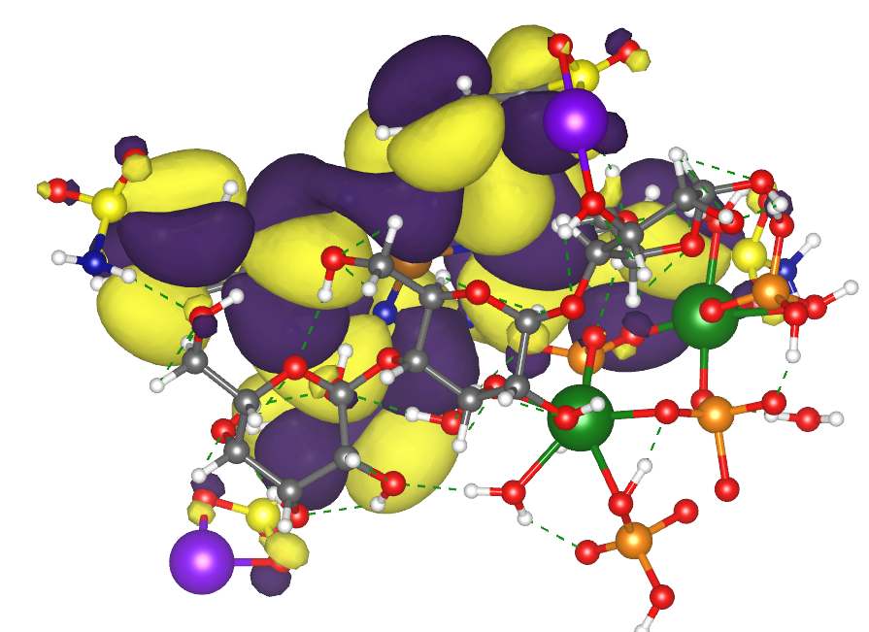
Cellulose-brushite-dye2
HOMO
LUMO

Slide 21
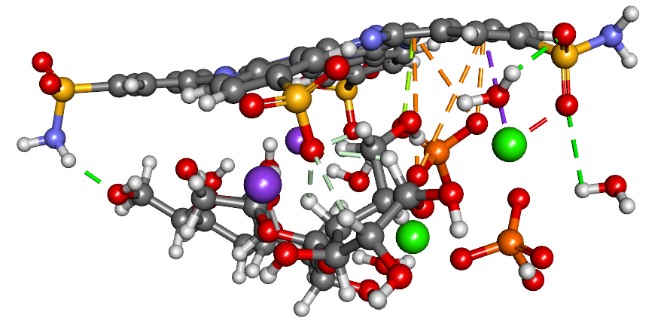
Dye2
Surface
Cellulose-brushite-dye2

Slide 22
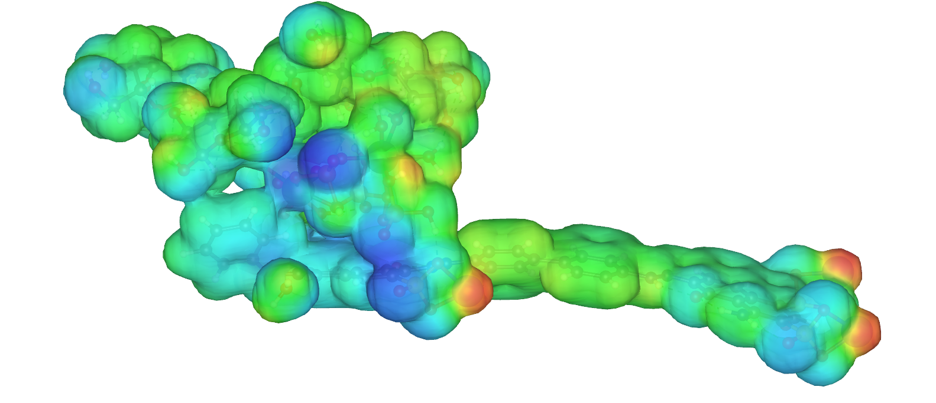
MEP HEMICELLULOSE-BRUSHITE-DYE1

Slide 23
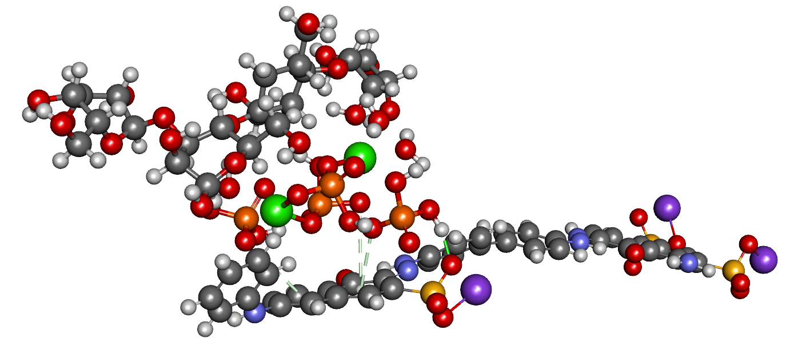
Hemicellulose-brushite-dye1

Slide 24
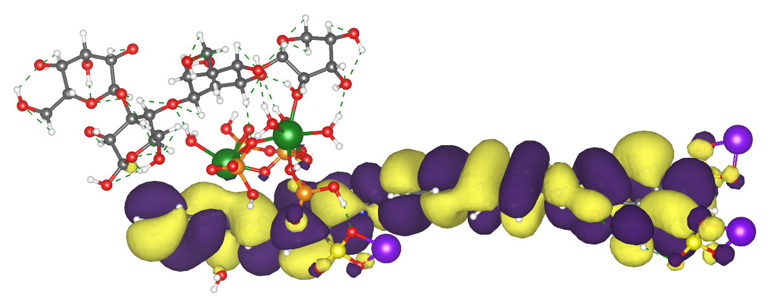
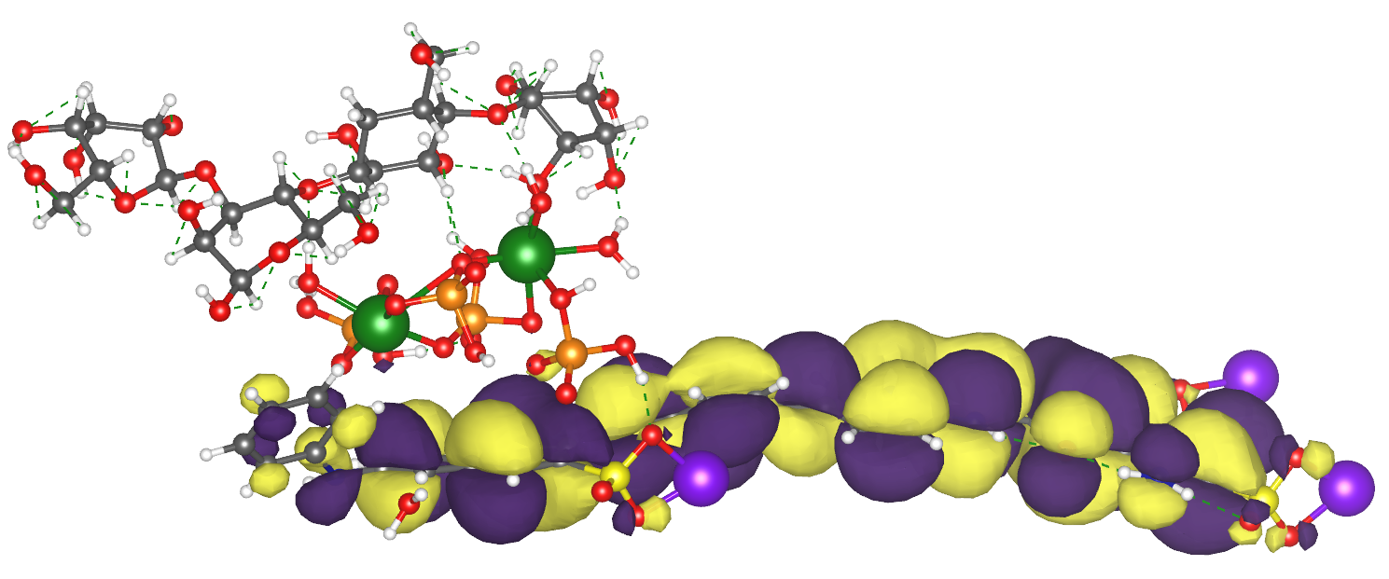
HOMO
HEMICELLULOSE-BRUSHITE-DYE1
LUMO

Slide 25
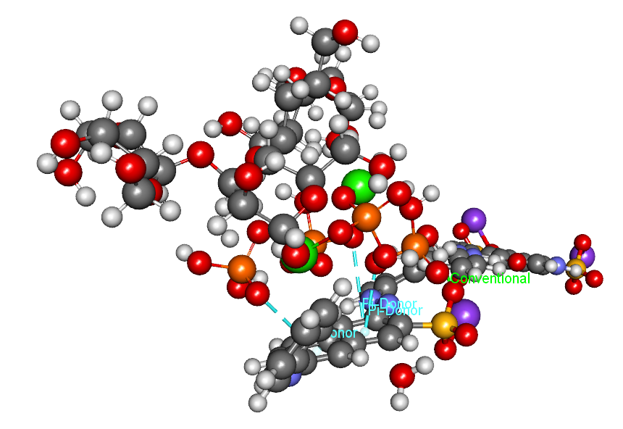
Hemicellulose-brushite-dye1

Slide 26
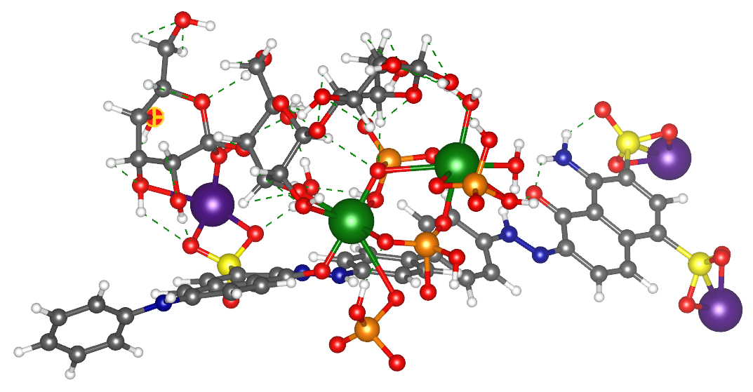
Cellulose brushite dye1

Slide 27
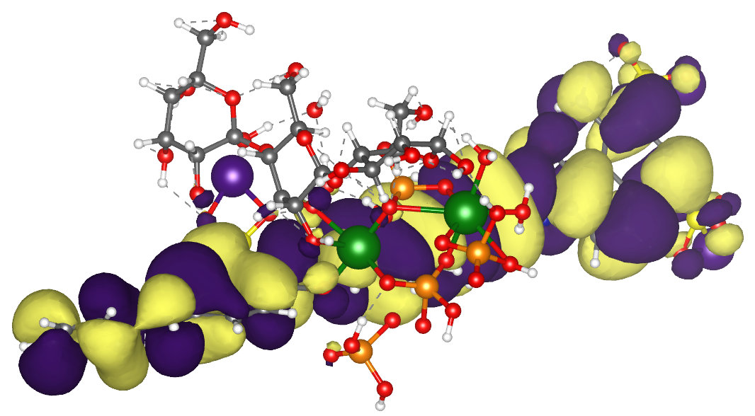
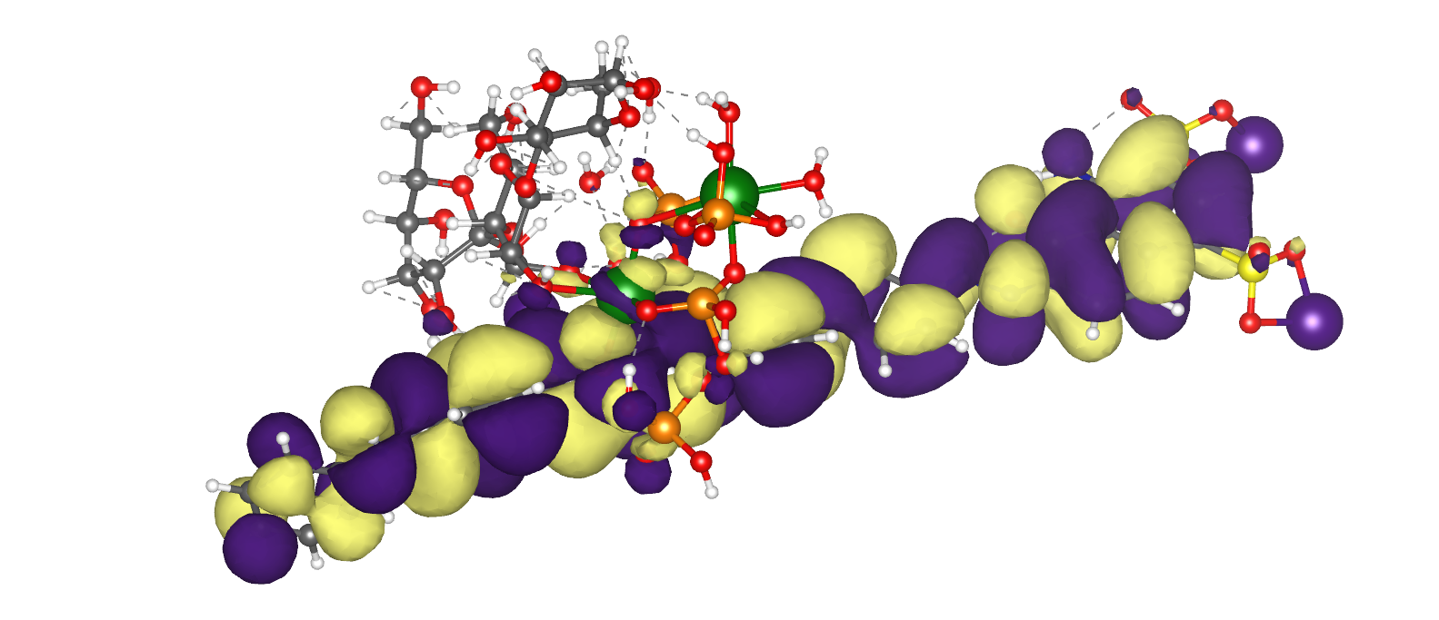
homo
Cellulose-brushite-dye1
lumo

Slide 28
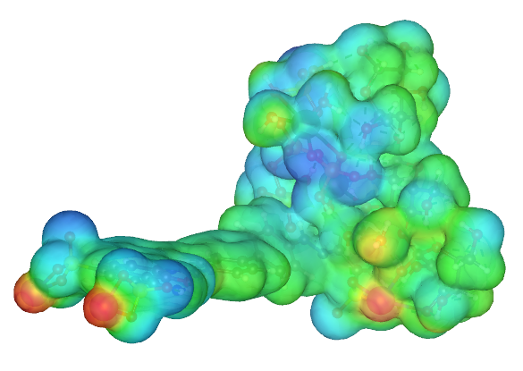
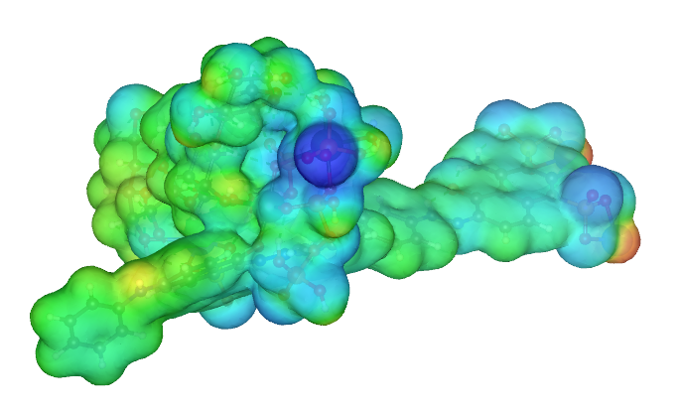
CELLULOSE-BRUSHITE-DYE1
POSE 1
POSE 2

Slide 29
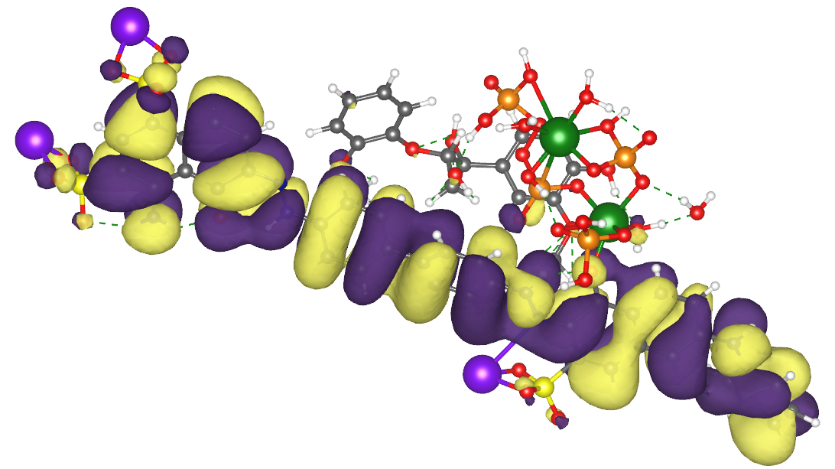
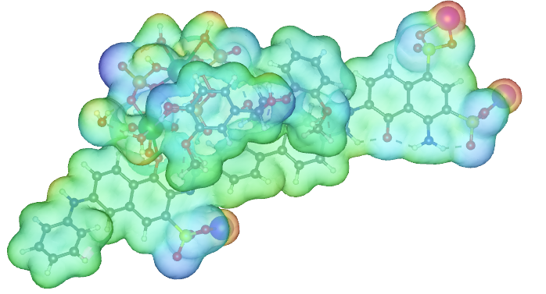
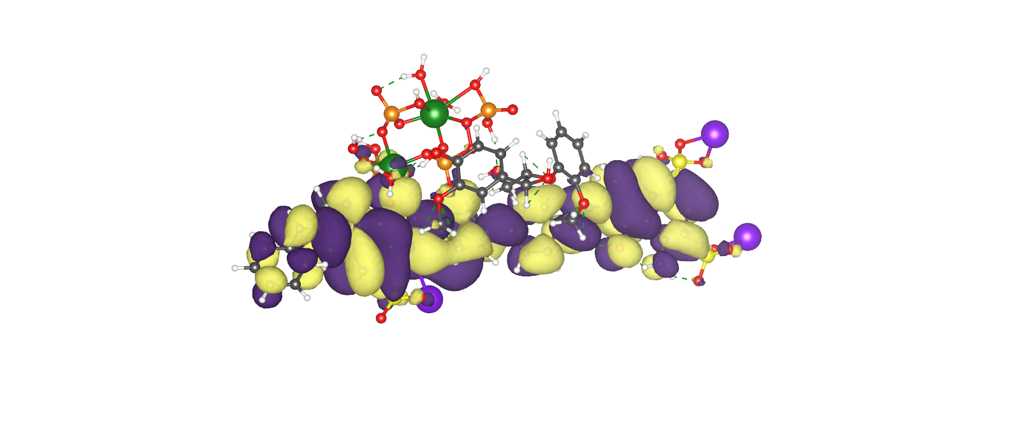
LIGNIN-BRUSHITE-DYE1
HOMO
LUMO
MEP

Slide 30
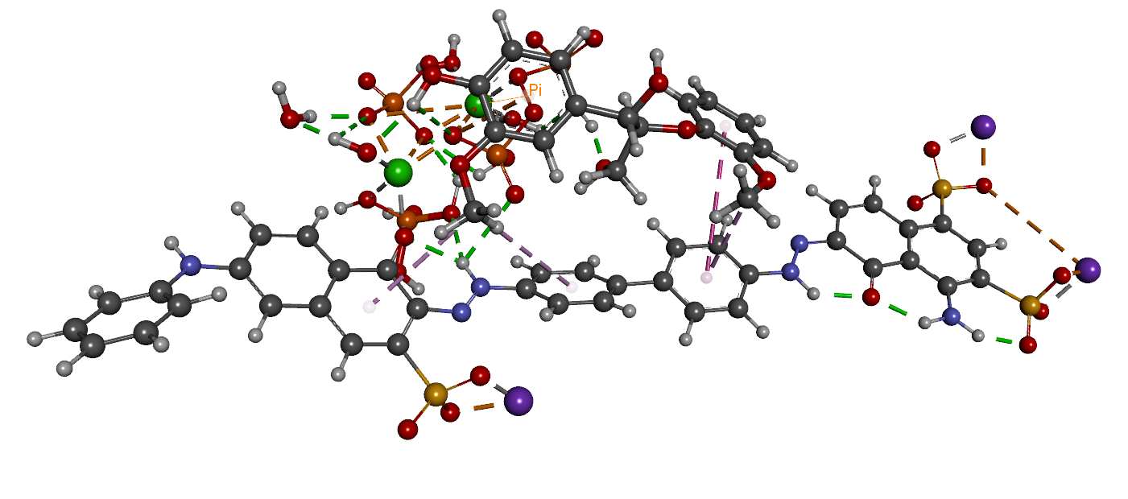
LIGNIN-BRUSHITE -DYE1

Slide 31
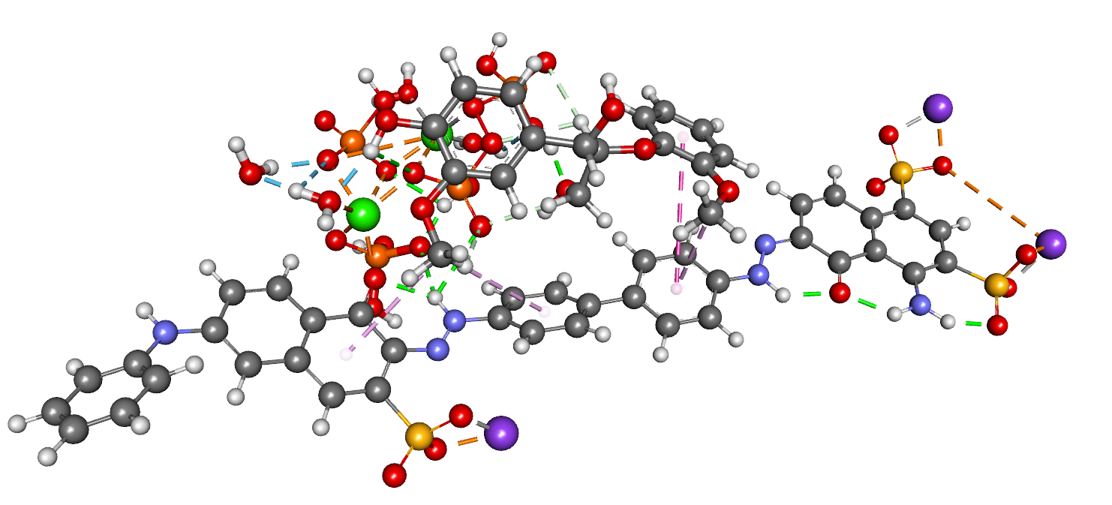
LIGNIN-BRUSHITE DYE1

Slide 32
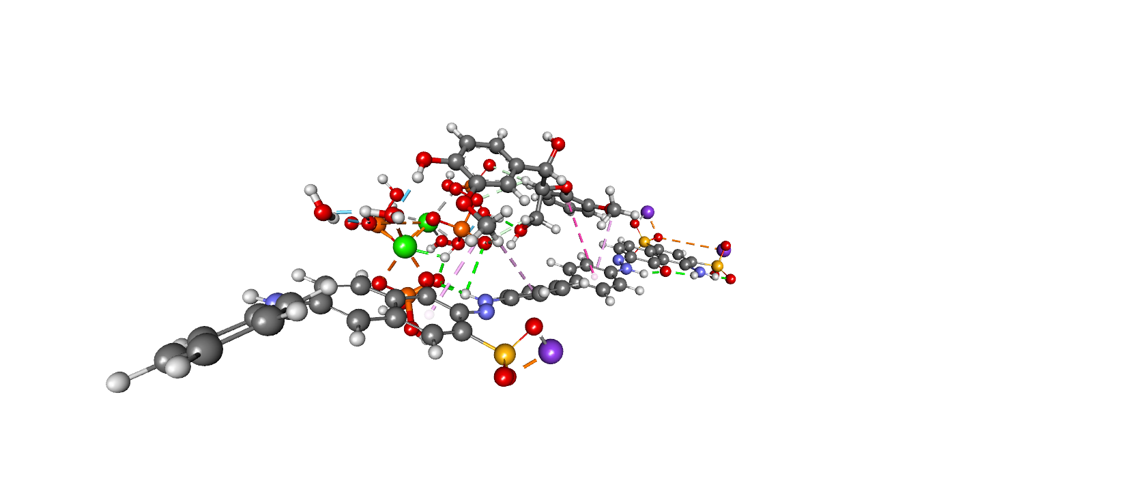
LIGNIN-BRUSHITE DYE1

Slide 33
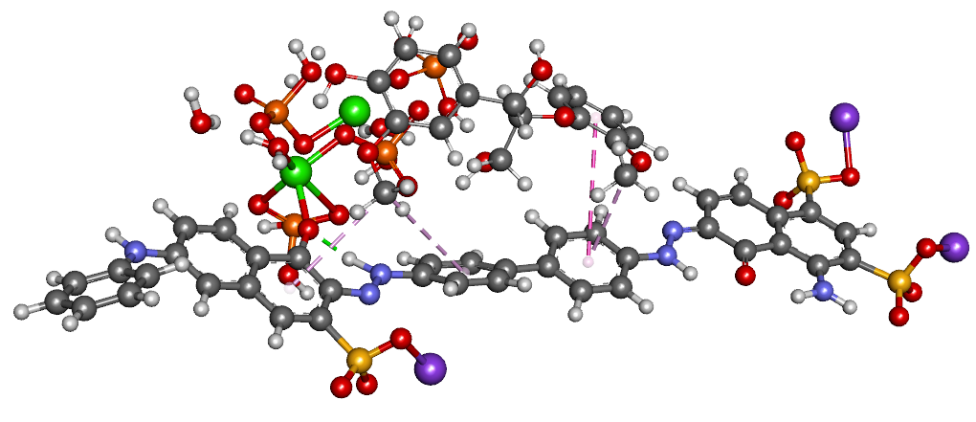
LIGNIN-BRUSHITE DYE1

Slide 34
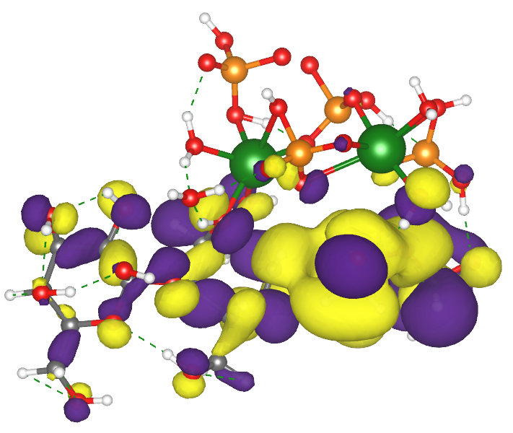
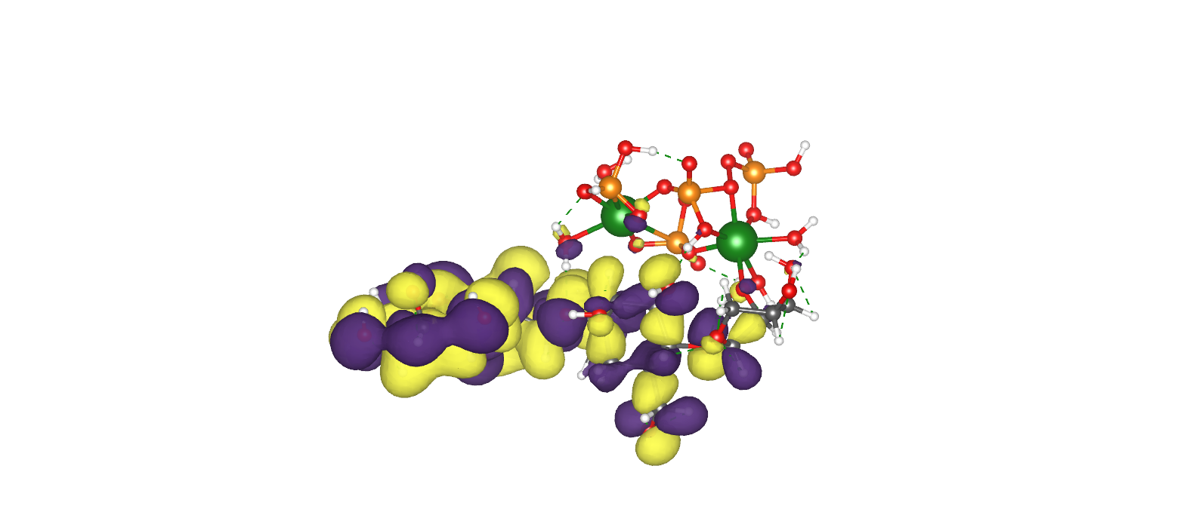
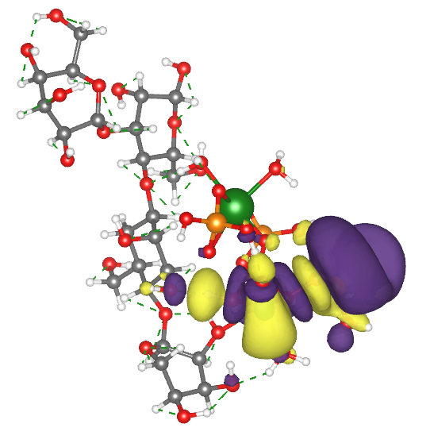
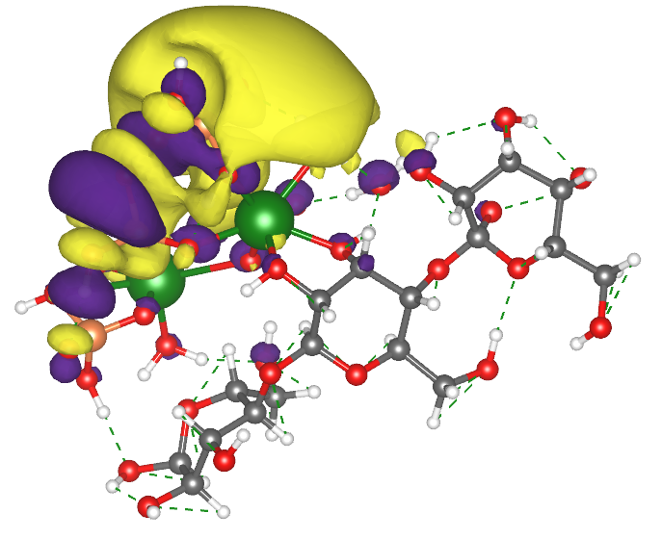
CELLULOSE
Hemicellulose -brushite
E_{HOMO}= –6.9902eV
E_{LUMO}= –0.1904eV
ΔE= 6.7992eV
Hemicellulose-brushite

Slide 35
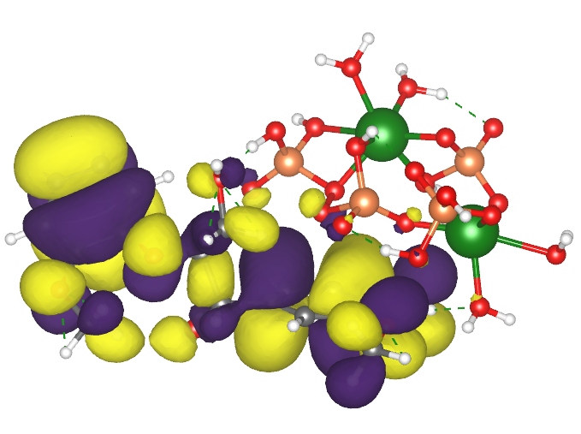

Lignin brushite

Slide 36


Cellulose-brushite optimized structure
HemiCellulose-brushite optimized structure

Slide 37


MEP Cellulose-brushite
MEP hEMICellulose-brushite

Slide 38


Lignin-Brushite
MEP
OPTIMIZED STRUCTURE

